Slide 1
MYLEGION: REPORTS
LGN and SAL Consolidated, Membership, and Revitalization reports. Create a renewal letter and labels.
2025

Slide 2
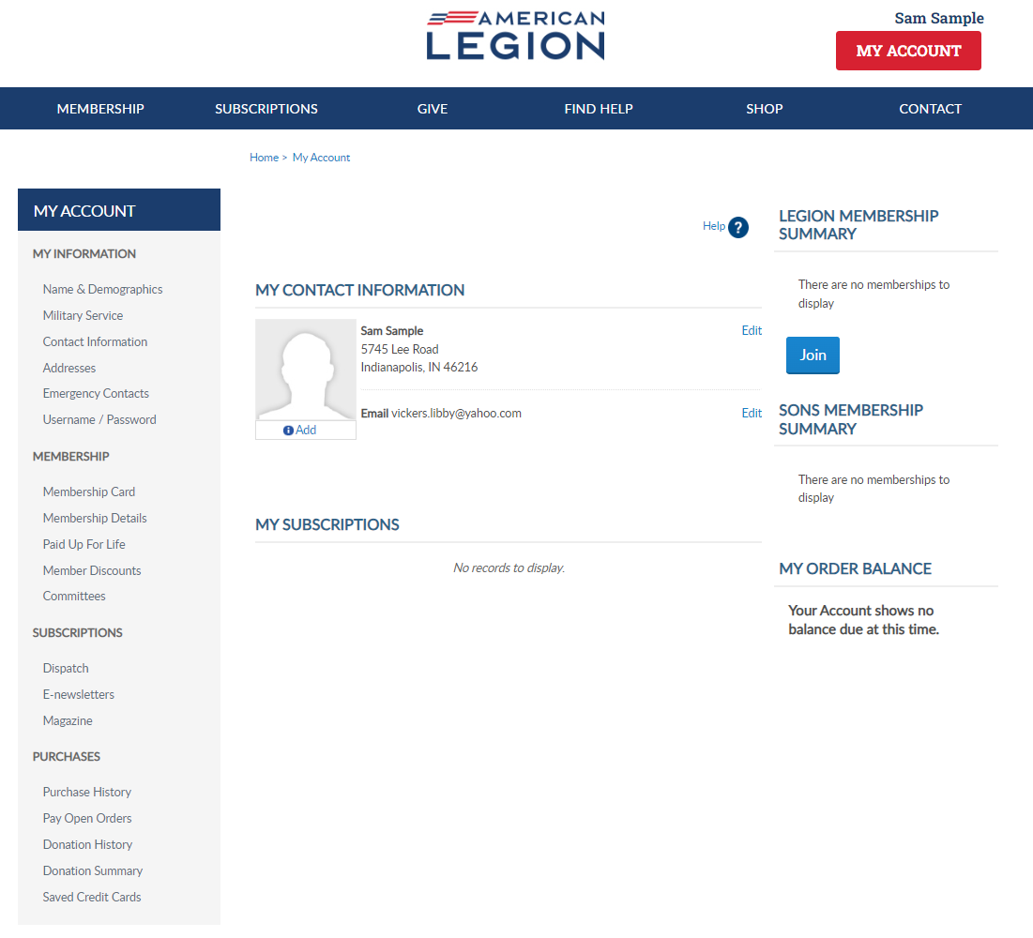
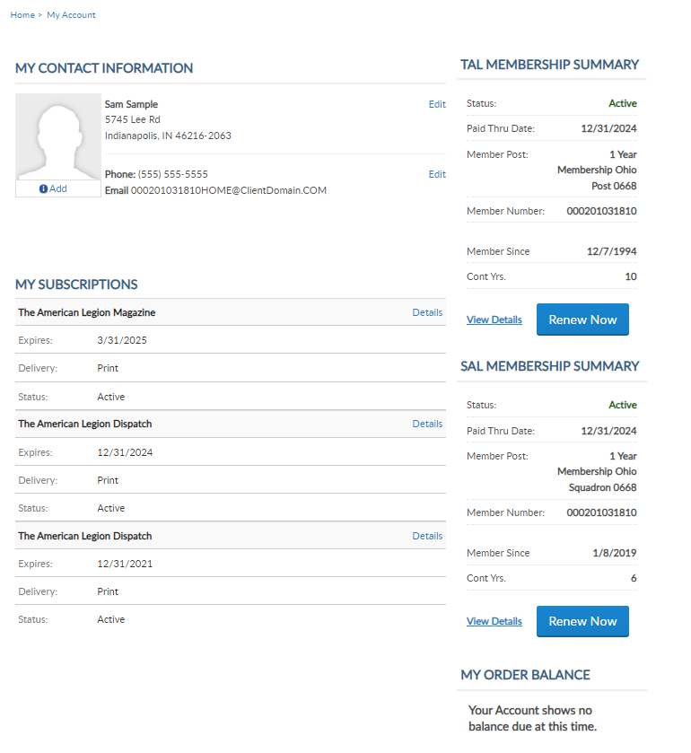
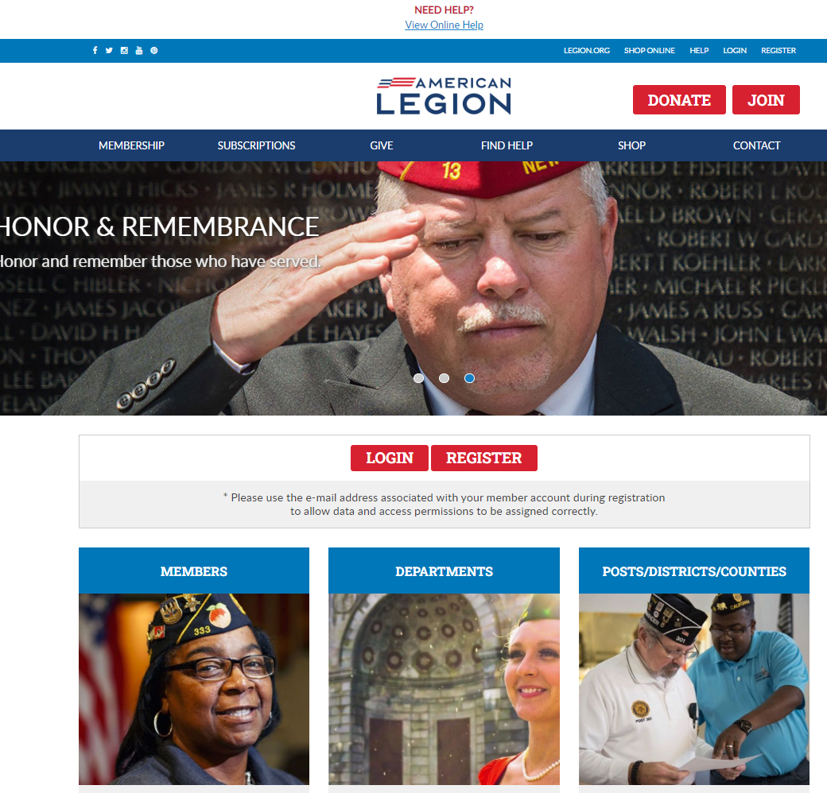
MYLEGION.ORG
emailaddress@yahoo.com
000123456789
Expired
000123456789
Notes:
Administrative membership management tools are available through MyLegion. Begin by logging into MyLegion and proceed to the My Groups menu. My Groups is the administrative side of myLegion available to adjutants and commanders and assigned administrators. If you do not have a My Groups menu and are a current adjutant or commander, contact your department headquarters.

Slide 3
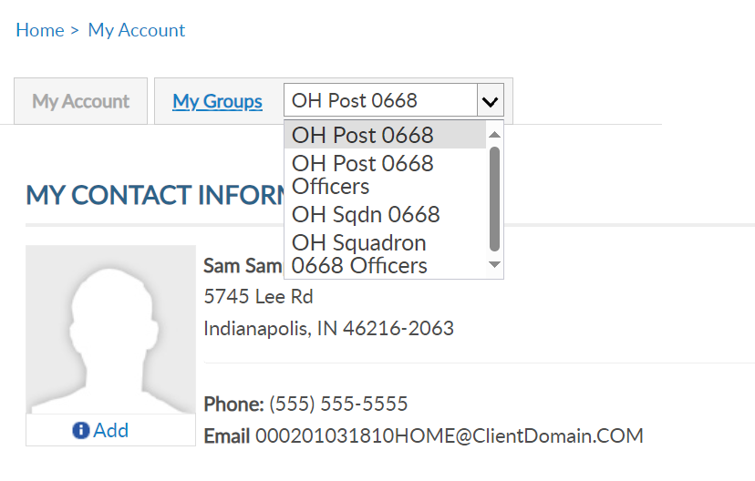
MY GROUPS
Post Adjutant
LGN Leadership has LGN and SAL data
Officer Groups: view only
emailaddress@yahoo.com
000123456789
Expired
000123456789
Notes:
Post Adjutants and Commanders will have 4 groups. One for the post, post officers, squadron and squadron officers.
Squadrons only have squadron groups. Counties and districts will also display if applicable.
To mange your group and generate reports, click on the group in the menu. Let’s go to a post. Click on the post in the menu and the group profile window will display.

Slide 4
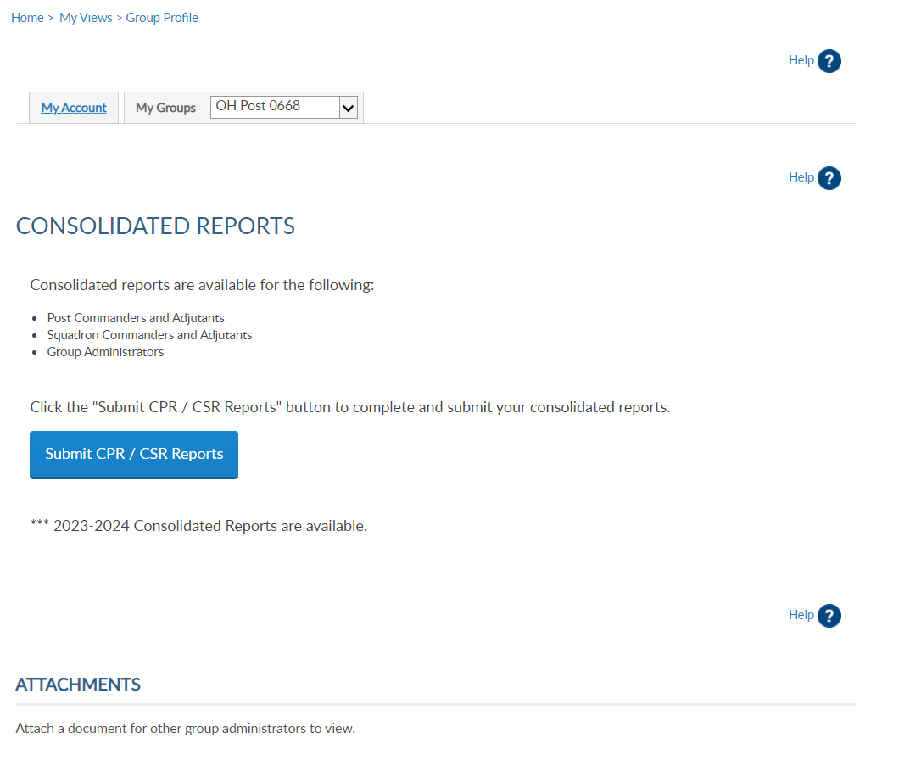
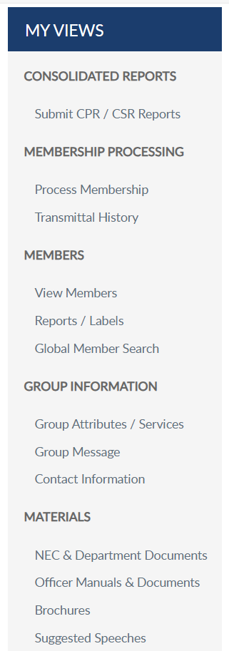
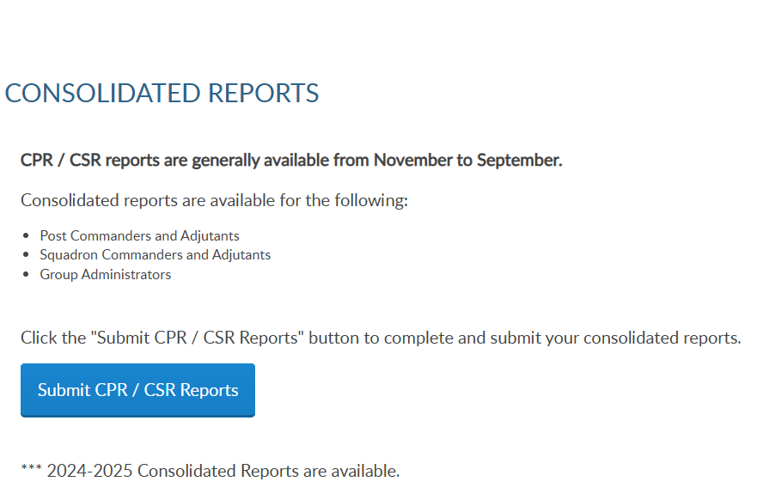
GROUP PROFILE
Notes:
Group profile includes a menu with administrative tools including consolidated reports, membership processing, member management, reports, labels and search options, as well as group information and officer materials.
MyLegion reports are found in the left menu and consolidated reports display as the group profile main landing page. To submit or view a consolidated report, select “Submit CPR/CSR Reports. <1>

Slide 5
Do not submit a paper form if submitting online.
Departments have access to online reports.
Notes:
There are 3 view areas in consolidated reports. Open reports are available to enter data while in draft status.
There is only one open report for the reporting year. When available, you can edit the report until the report is submitted or the final submission date.
To enter information in the report, click Edit. <1> If you submit online, you do not need to mail a paper form. The department has access to submitted report data.

Slide 6
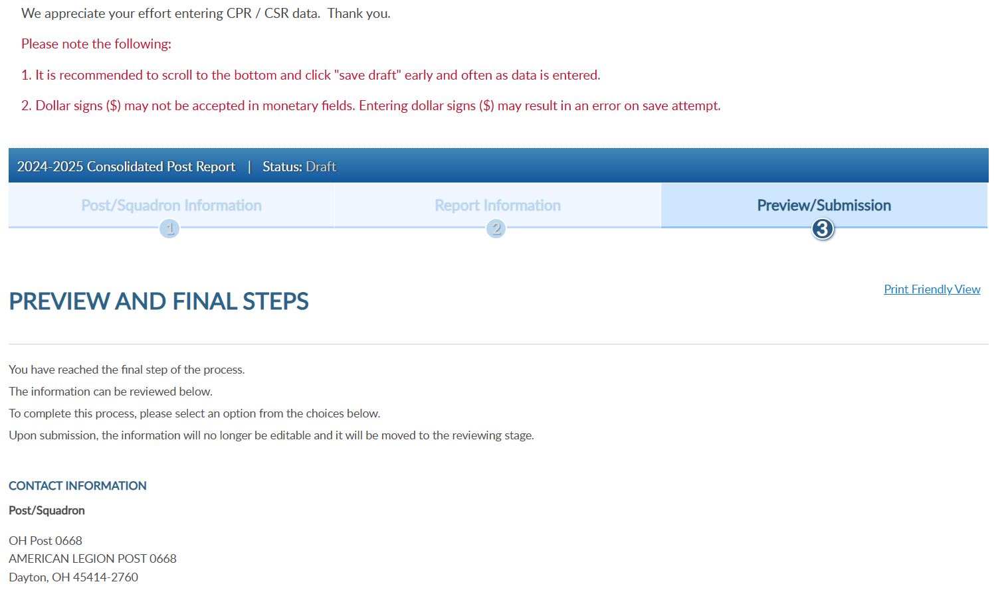
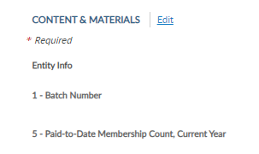
Notes:
Click edit to open the fillable form. <1>

Slide 7
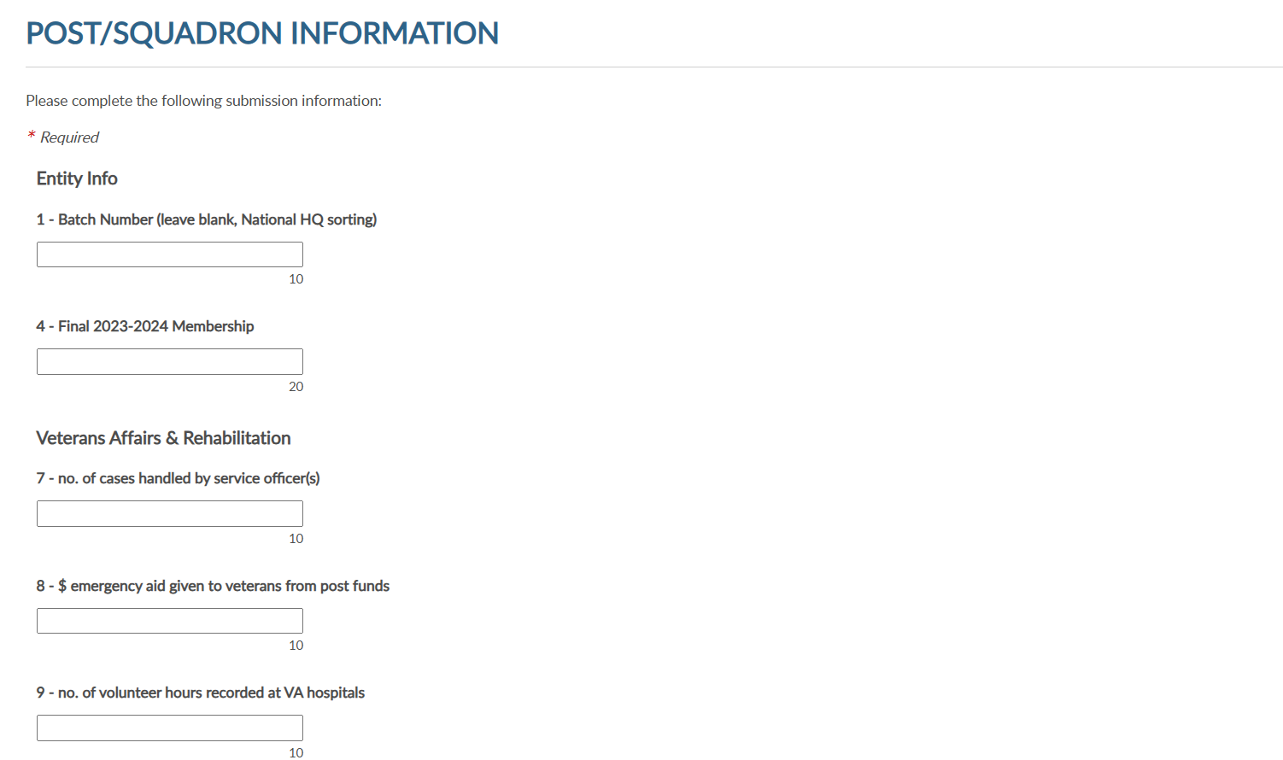
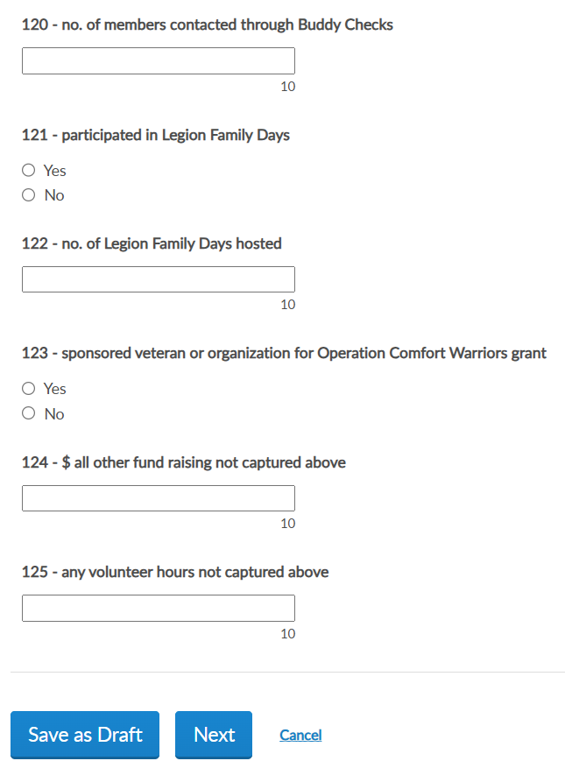
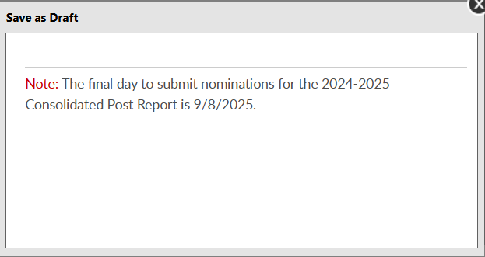
Notes:
When your entries are complete save the draft or finalize the report. These buttons are located at the bottom of the form. <1>
To save and return to the form later, choose Save as Draft. <2> the draft must be finalized by the assigned deadline.

Slide 8
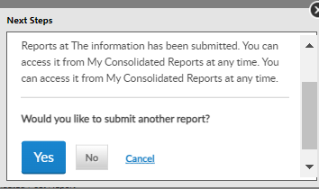
Notes:
To finalize the report, click Next <1> to view and select the Submit Final button. You will receive a notification the report is submitted. <2>
Note, once the report is finalized it is saved as a submitted report. You will not be able to add data. If you plan to make additional updates, click Save as Draft and finalize by the due date.

Slide 9
03/01/2025
Notes:
Submitted reports will remain in the Open area with a submitted status until the report is closed for the year. To view, or print a report click View. <1>

Slide 10
Notes:
Use the navigational tools to view next page or full list.

Slide 11
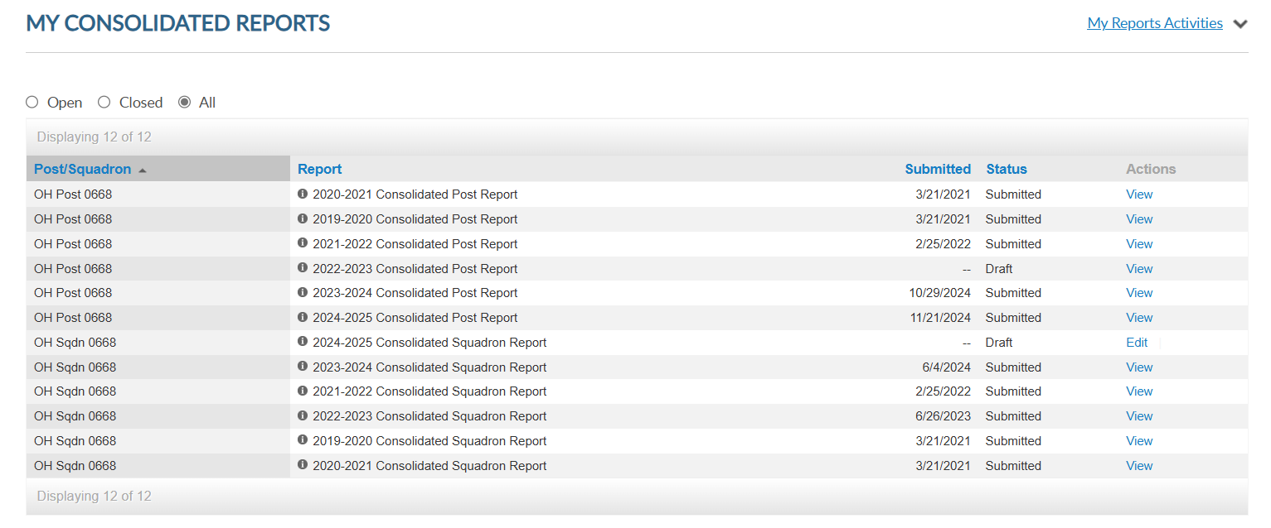
03/01/2025
Notes:
The All section includes open and closed reports.

Slide 12
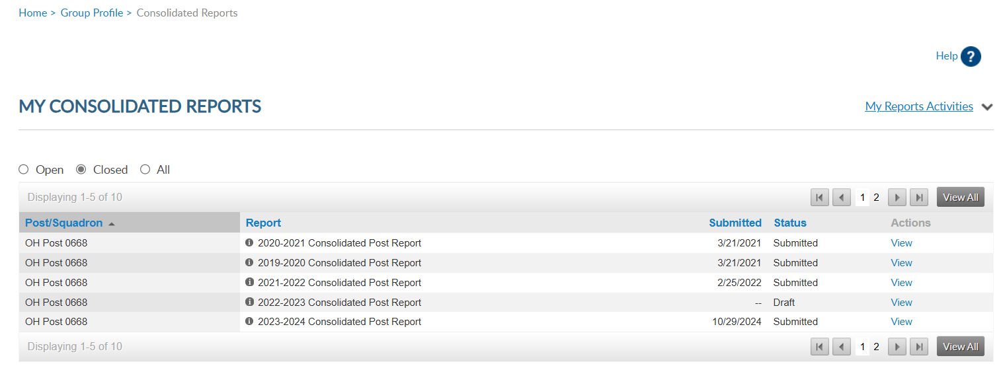
Notes:
Closed reports do not display open reports. You can view and print all reports. Click view to open and print.

Slide 13
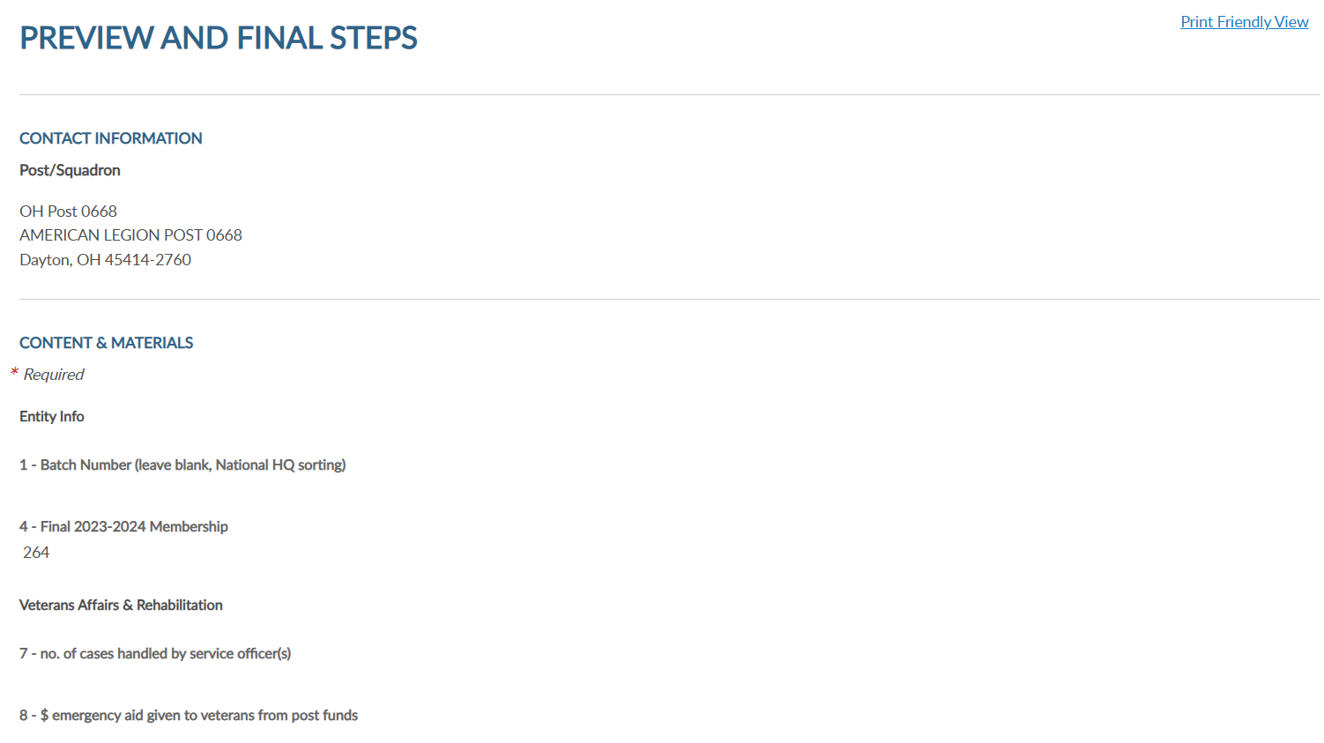
Notes:
Select Print Friendly View to advance to Print. This allows you to print the report as a PDF document.

Slide 14
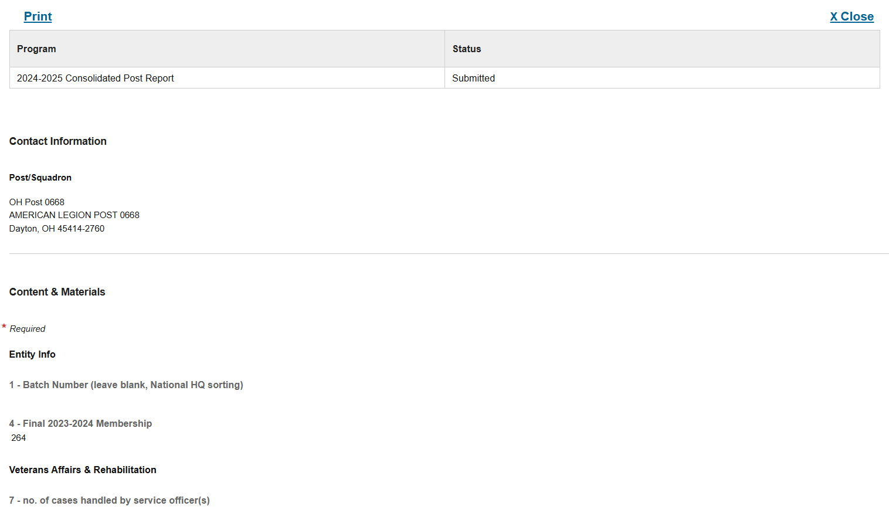
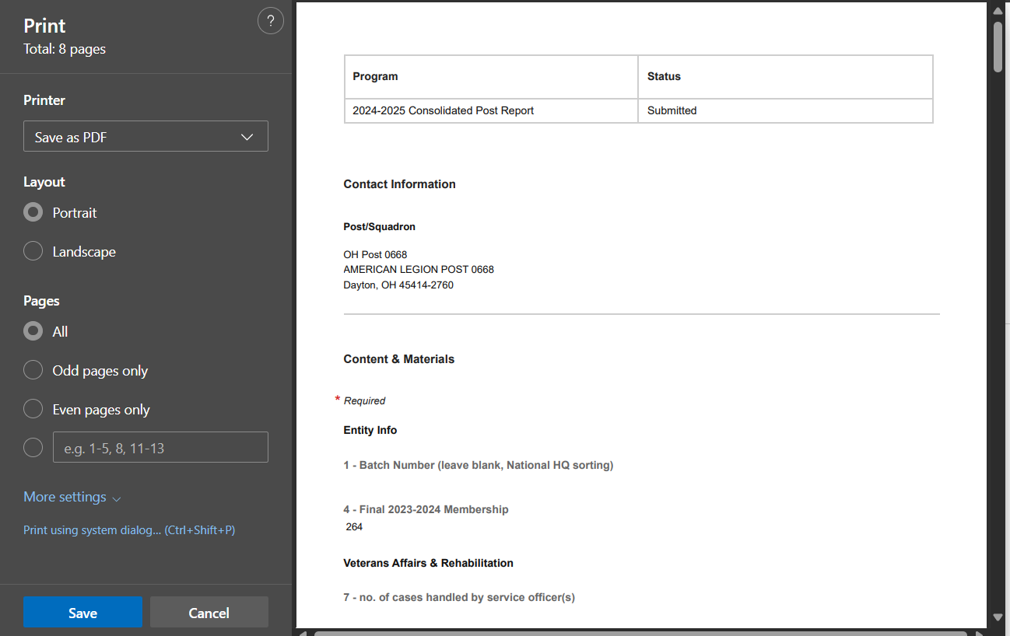
Notes:
Select print to open as a PDF document. <1>

Slide 15
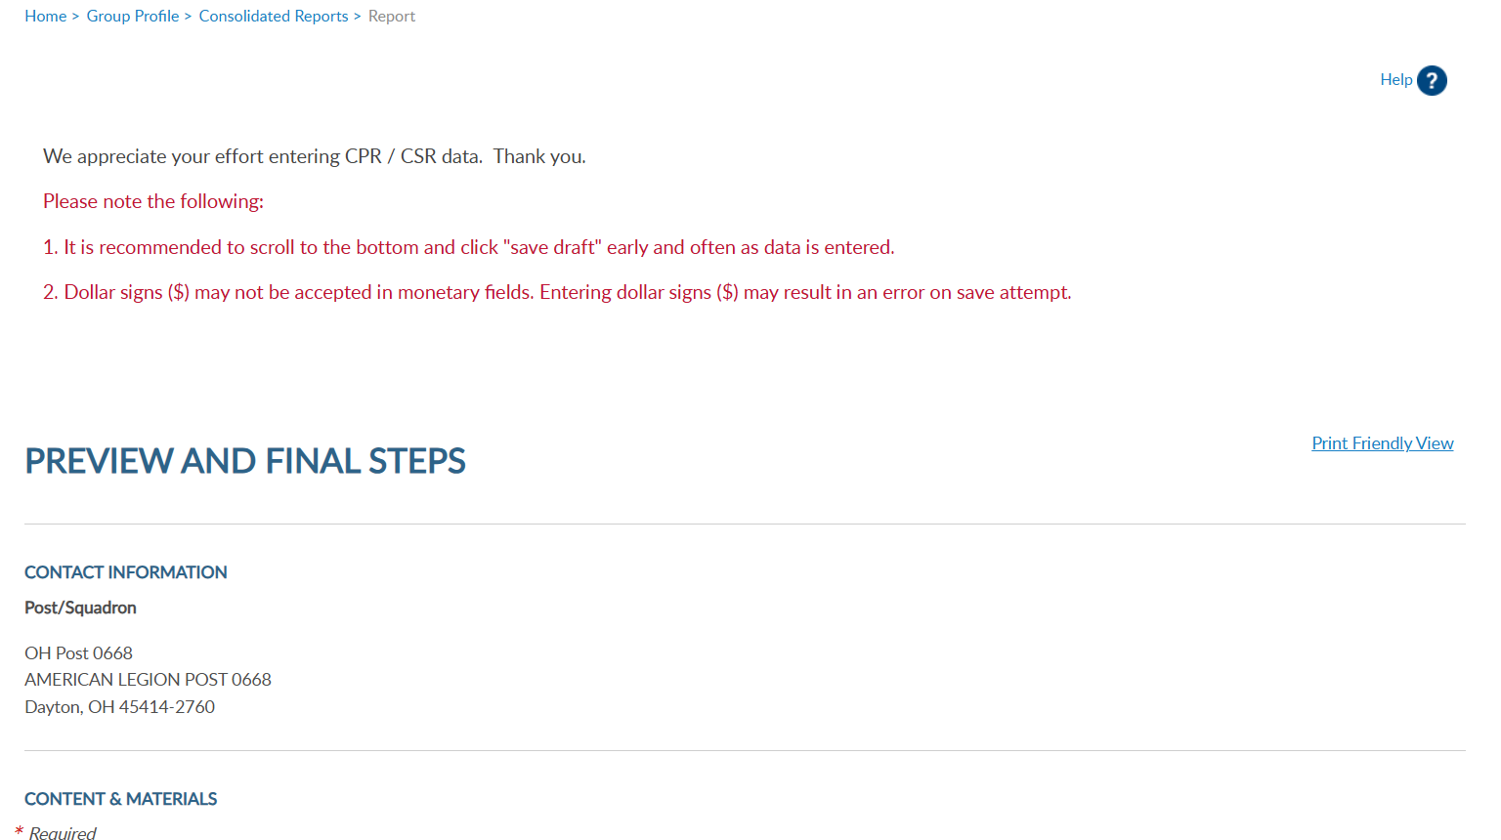
Notes:
Click on Group Profile to return to group administrative window.

Slide 16
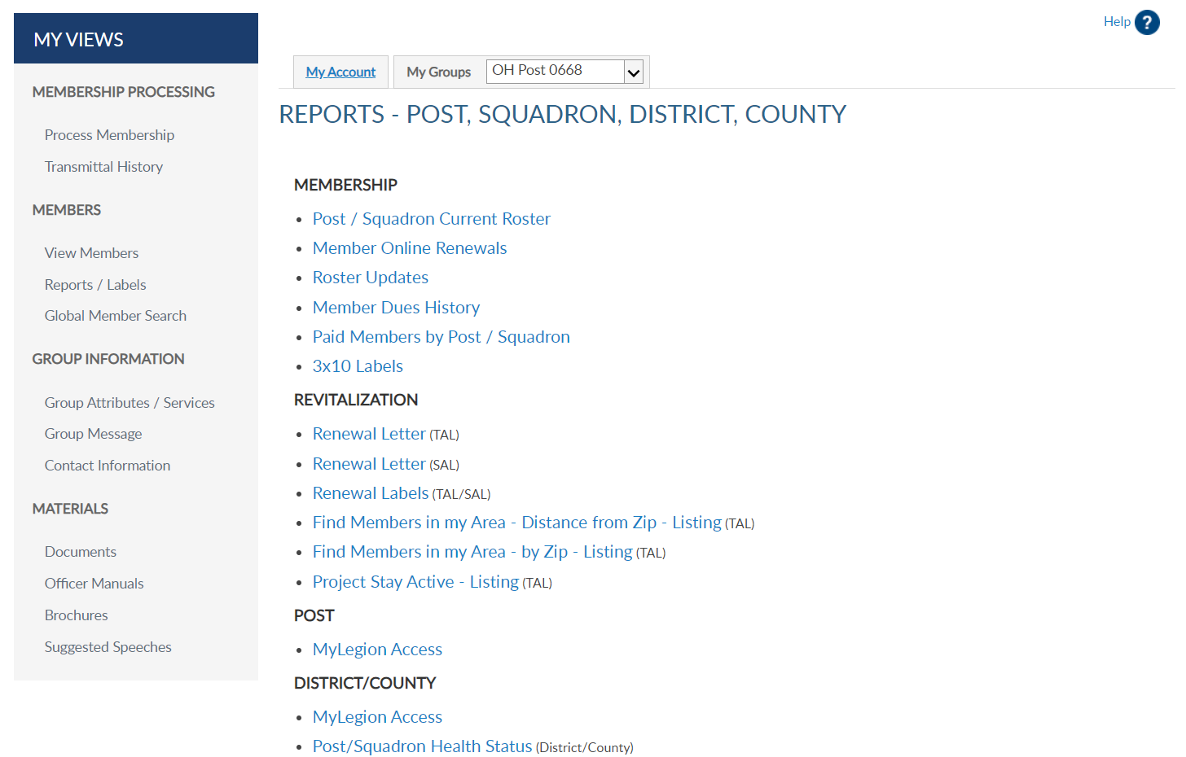
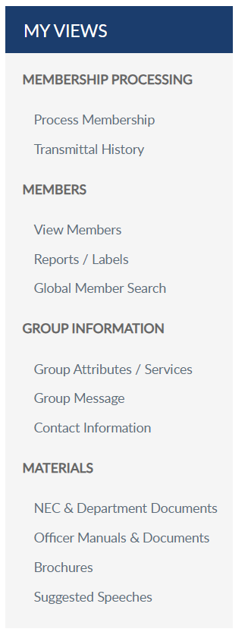
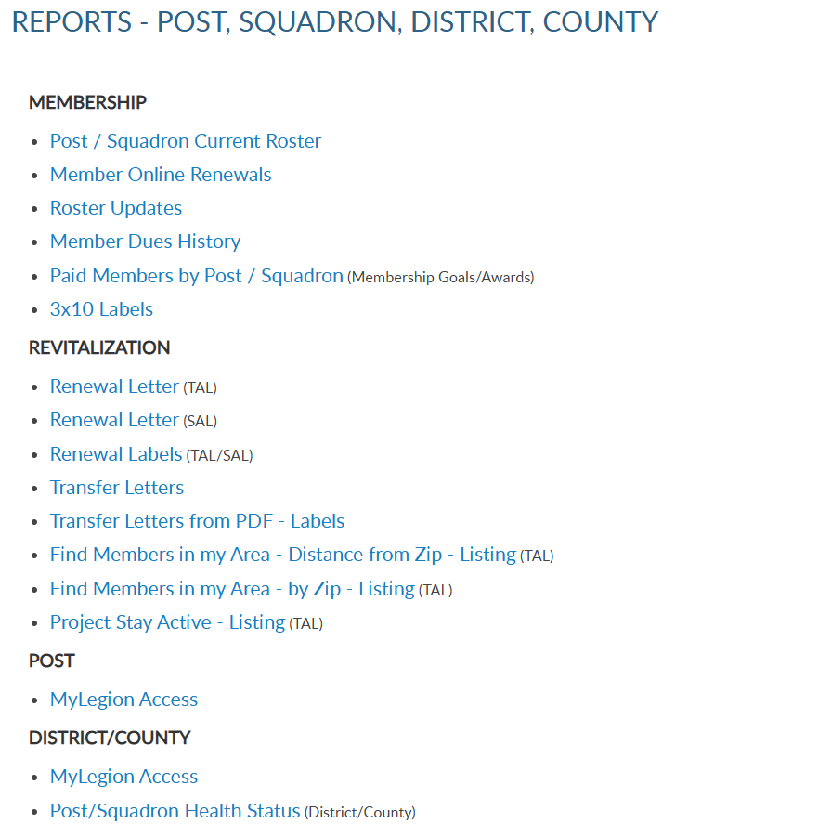
Notes:
Membership listings, roster updates, members renewed online, HQ member listings, mailing labels and a renewal letter are available through Reports/Labels.
Reports include post and squadron membership assigned to your group. To generate reports, you will first select the report and then the group and criteria. Let’s begin with a current roster report. Click on the report name to proceed.

Slide 17
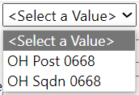
Displays members who are currently assigned to your post. Includes expired and deceased.
CURRENT ROSTER
Legion members can purchase a 3-year membership. Paid 2024 members can renew for 2025, 2026, and 2027.
Legion members paid 2025 can purchase a Paid Up For Life membership. Last Paid Yr = 2026.
Notes:
This listing only includes current members of your group. Members who have transferred out, are not included in current membership. To view members who have paid to your post or squadron, generate a Paid Members report.
All reports are created using data filters. Filtering menus allow flexibility to the data included in the roster. The first field selected is Group. Using the pulldown menu. A group can be post, squadron, county, and district First select the group. Next select last paid year. <2> Last paid year on a member’s record will list the year of future paid years. <3> Legion members who purchase a multi-year renewal display a last paid year that has been purchased.
<4> Legion members who are currently paid that purchase a Paid up For Life membership will also display a last paid year of which PUFL allotment will be due the post.
When selecting last paid year, keep in mind any members with a future last paid year, must be paid for the current year.

Slide 18
Displays members who are currently assigned to your post. Includes expired and deceased.
CURRENT ROSTER
Notes:
Status includes active and deceased. Deceased members will remain on the roster and can be filtered out by selecting active only.
<1> The next filter is mailing status. Mail status let’s you know if the mailing address on file is good or flagged as undeliverable. Members with undeliverable status do not receive The American Legion Magazine, renewal notices, or any mailings from National Headquarters. Contact those members, if possible, to collect a valid mailing address and update. Updating an address that marked as undeliverable will remove the flag. If a member states the address on file is good, contact National Customer Service to remove the flag.

Slide 19
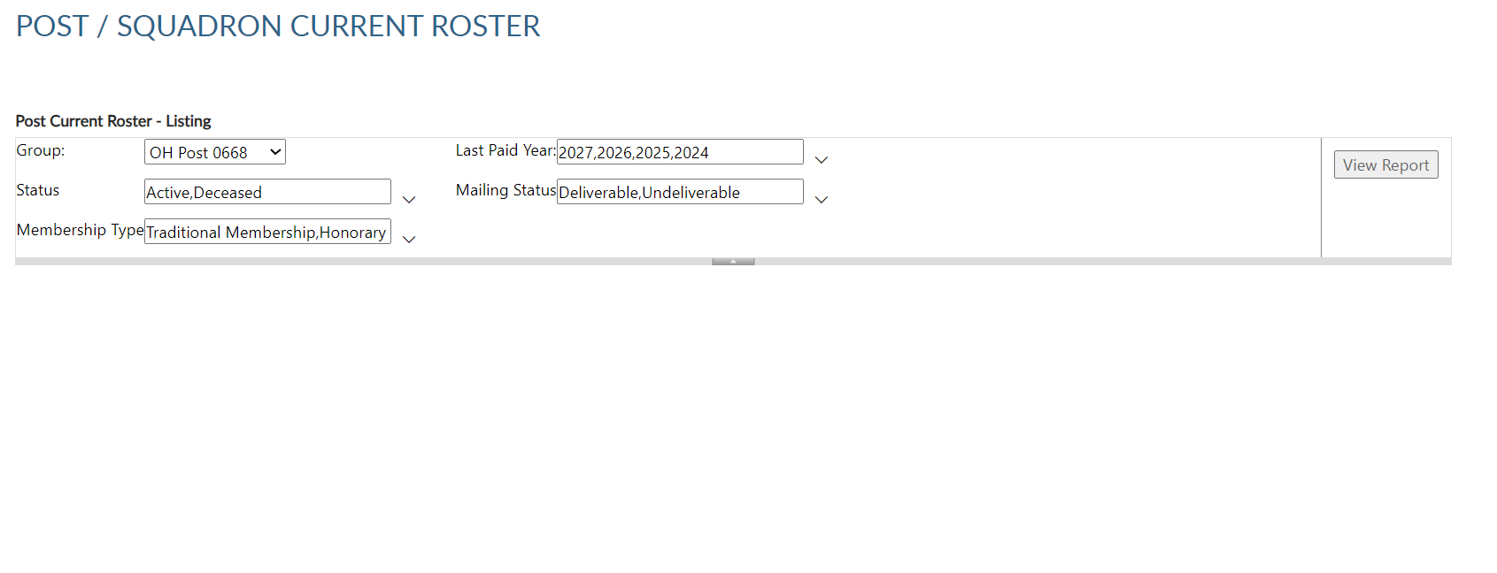
Displays members who are currently assigned to your post. Includes expired and deceased.
CURRENT ROSTER
Notes:
Status includes active and deceased. Deceased members will remain on the roster and can be filtered out by selecting active only.
<1> The next filter is mailing status. Mail status let’s you know if the mailing address on file is good or flagged as undeliverable. Members with undeliverable status do not receive The American Legion Magazine, renewal notices, or any mailings from National Headquarters. Contact those members, if possible, to collect a valid mailing address and update. Updating an address that marked as undeliverable will remove the flag. If a member states the address on file is good, contact National Customer Service to remove the flag.
<2> Membership type includes traditional 1-year renewal, honorary life, department life, paid up for life and if the member is a current transfer.
<3> After all data fields have been set, click View Report.

Slide 20
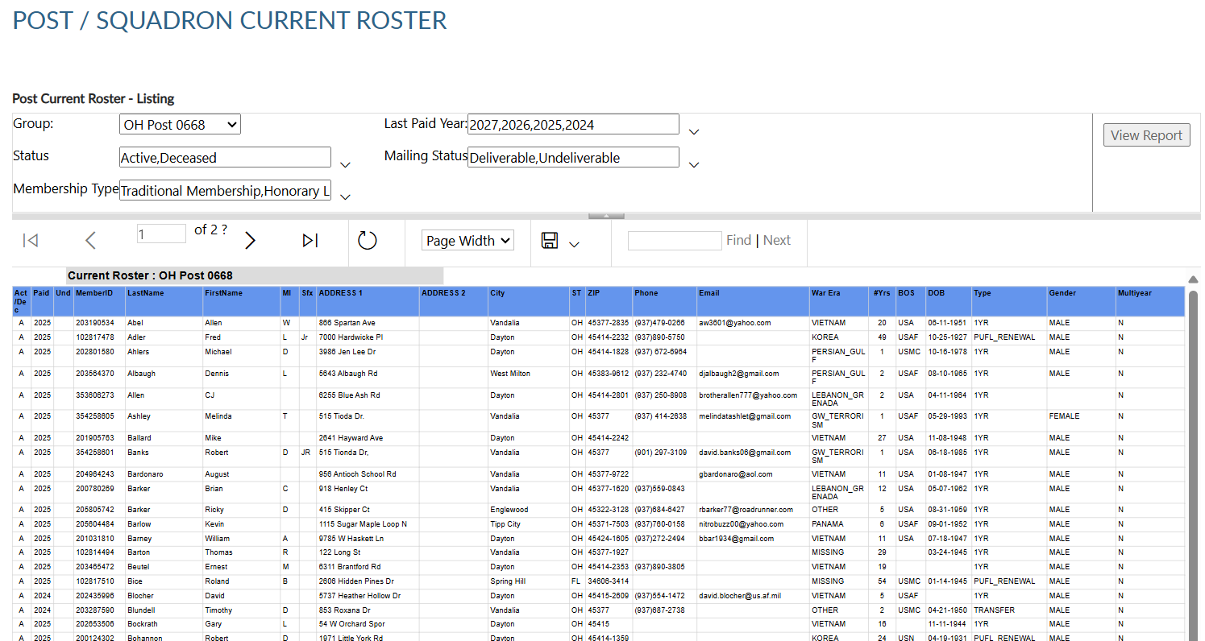
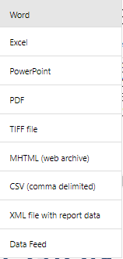
Notes:
The roster includes status, paid year, contact information, conflict, continuous years, branch of service, date of birth and membership type. Using the export Icon, export to an Excel document. <1>

Slide 21
Notes:
This report includes deceased and undeliverable members. It also includes members paid for the current membership year and future renewals.

Slide 22
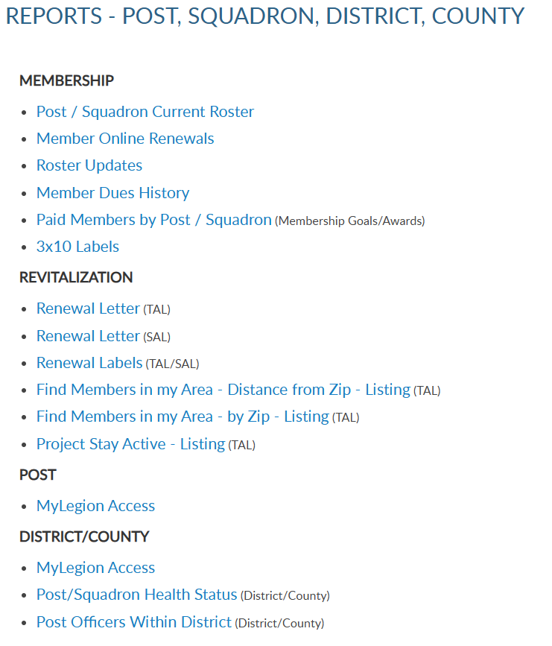
Notes:
Legion members that renew online can be identified using the Member Online Renewals Report.
Online renewal is available for Legion and Sons of the American Legion membership.
Click on the blue hyperlink to begin the members online renewal report.

Slide 23
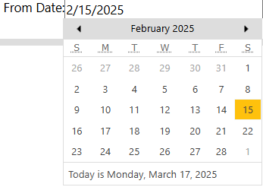
Lists member paid online through national headquarters.
MEMBER ONLINE RENEWAL
Notes:
Group selection is required. Date range selection is updated by clicking on the calendar icon. <1> Use the left and right arrows to navigate by month and year. Click on the date in the calendar to set. <2> Click View Report to generate listing.

Slide 24
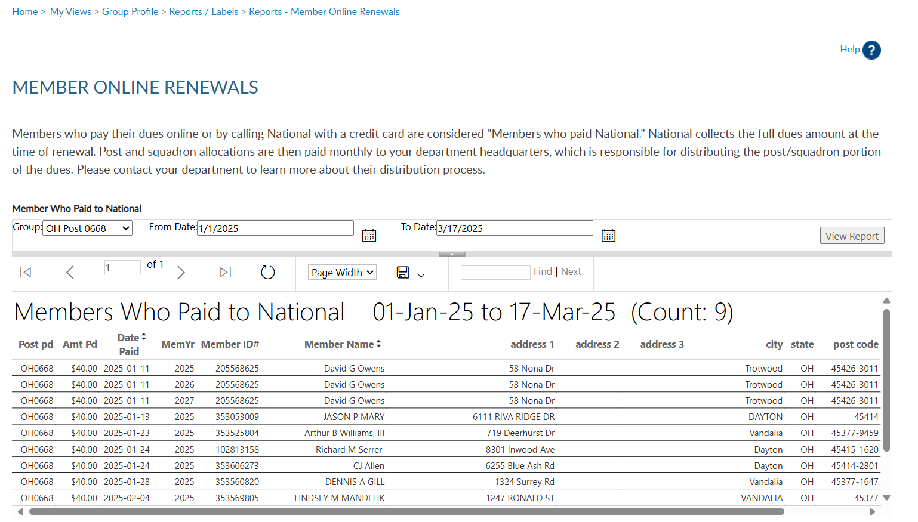
Lists member paid online through national headquarters.
MEMBER ONLINE RENEWAL
Notes:
This report provides the total count with names, member id#, date and renewal year. The amount paid displays the total amount of dues collected by the member, as reported on the annual post data report. When a member renews online, National collects post dues and sends all others to the department to distribute.
If the post dues do not cover the minimum of national plus department, online renewal will not be available and result in an error message if the member attempts online renewal.
The export icon <1> is used to print and save reports. Reports are not saved within the report writer.

Slide 25
Notes:
Members who renew for multiple years display. Notice John Sample renewed for 2025 and with the multi-year renewal option, also renewed for 2026 and 2027.
Posts and department will receive future dues in July of each membership year.

Slide 26
Notes:
The next report is Roster Updates. This report helps identify members who have transferred in and out of your post or squadron, new joins and other updates made on the member record.
Select Roster Updates blue hyperlink to begin.

Slide 27
Updates to member information for address, deceased status, transfer information and new members (new join).
ROSTER UPDATES
Notes:
Select your group and date range using the calendar icons. Select update type or all. After all filters are set View Report to generate. <1>

Slide 28
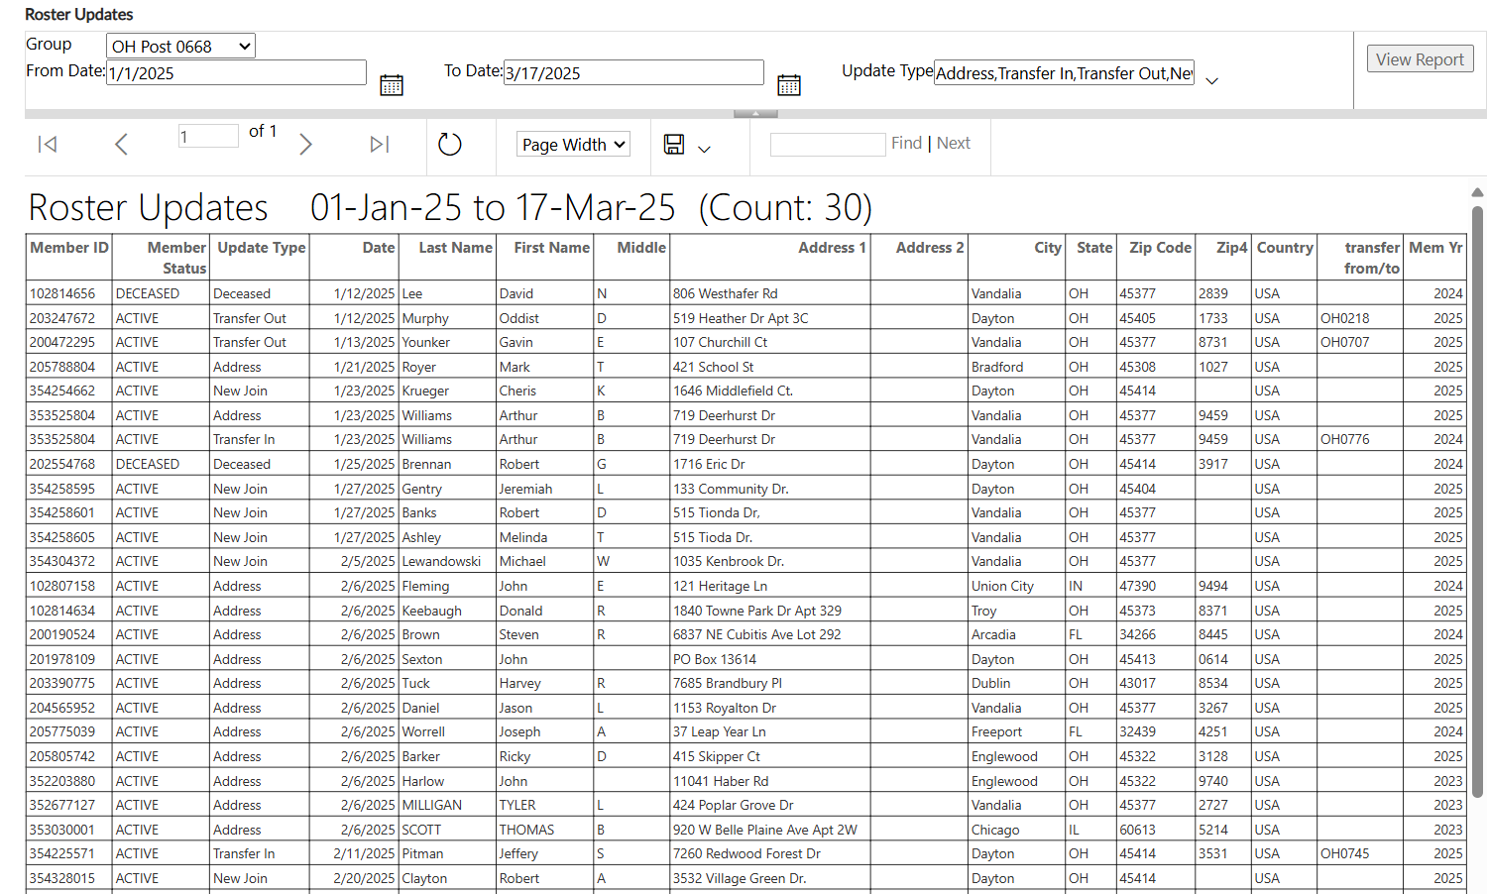
Updates to member information for address, deceased status, transfer information and new members (new join).
ROSTER UPDATES
Notes:
To print or save, export to an Excel Document or PDF. <1>

Slide 29
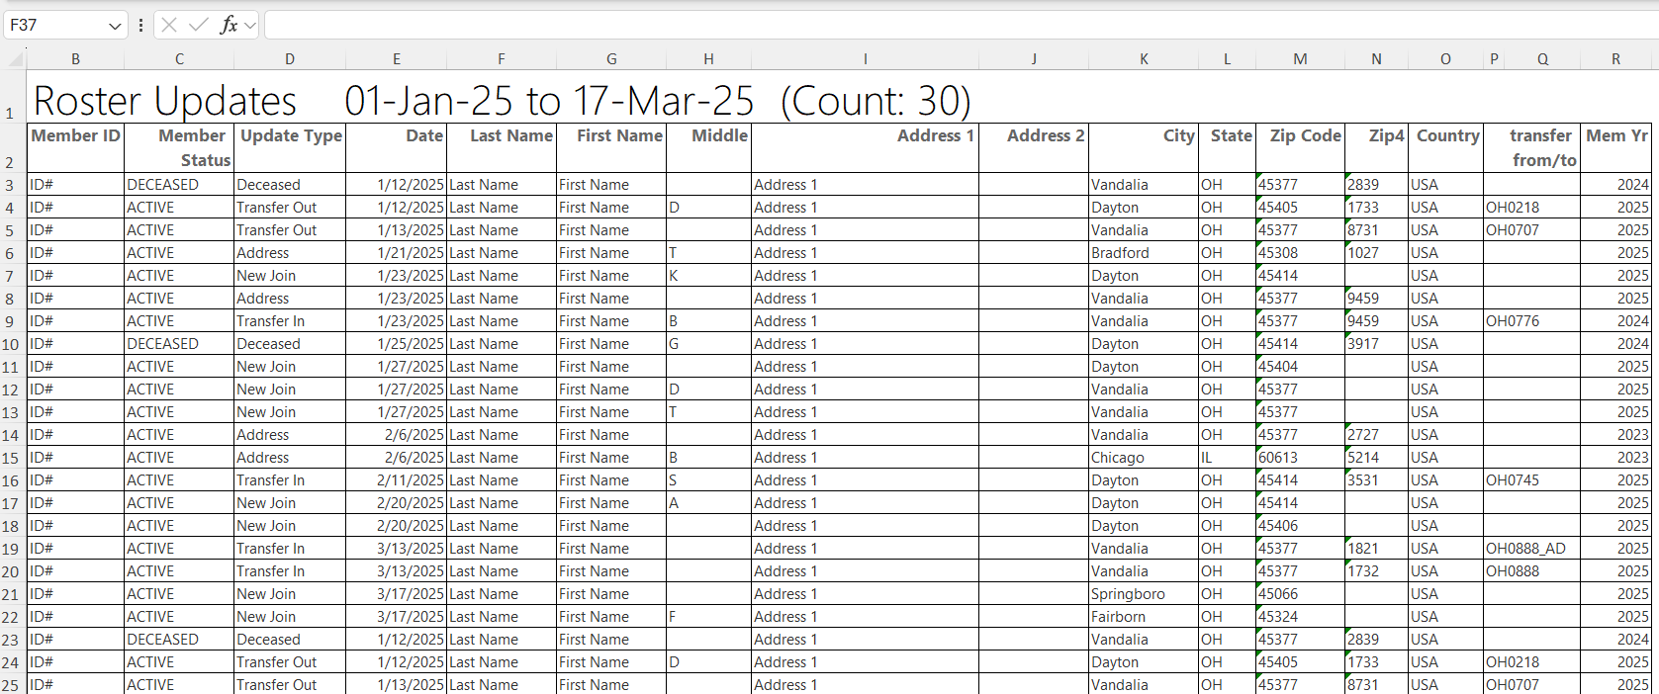
Notes:
The report gives you information on updates made to the member record. Notice transfer information includes to and from information. Members who transfer out of your post no longer appear in current roster or current membership reports. Paid members who transfer out will be included in the Paid Members report.

Slide 30
Notes:
Dues history report displays payment information from 2011 to present.

Slide 31
MEMBER DUES HISTORY
Displays member payments from 2011 to current.
123456789
Notes:
Enter the 9-digit membership number and organization, <1> and click View Report. Use the export icon to save or print. <2>

Slide 32
Notes:
Payment history includes 2011 to present. If more payment information is needed, contact your department headquarters. Departments can work with national headquarters to view archived data.

Slide 33
Notes:
The Paid Members report is the report corresponding with Department membership reports. It includes all members paid for the current year, even if they transferred out.

Slide 34
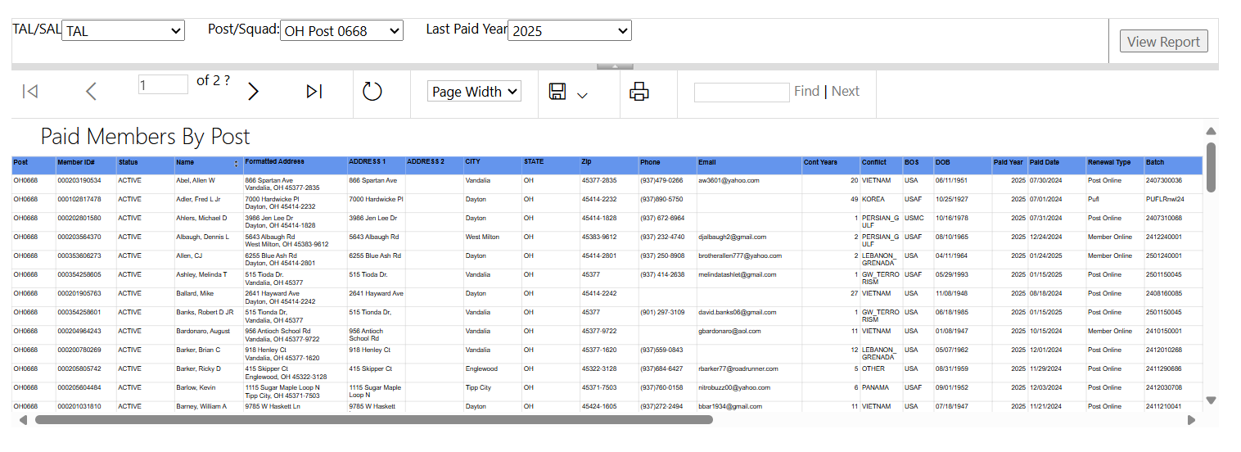
PAID MEMBERS
Paid members for the current membership year. Includes members who paid yet transferred out.
Notes:
Enter organization, group, and last paid year. Click View Report <1> to generate. Export the report to save and print. <2>

Slide 35
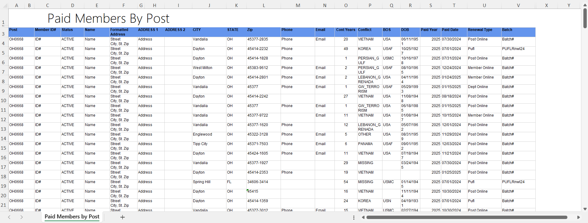
Both Encumbered and Unencumbered HQ transfers are included in this report. Please check with your department to see what counts towards annual membership goals.
Notes:
This report provides members paid to the post, even if transferred out. It also identifies the renewal type and batch number. The paid members report will correlate with department membership goals reports.
Both Encumbered and Unencumbered HQ transfers are included in this report. Please check with your department to see what counts towards annual membership goals.

Slide 36
Notes:
3x10 labels produce a 30 per sheet label that fits Avery 5160 or any 30/sheet blank labels.
Click on the blue hyperlink to set filters and create labels.

Slide 37
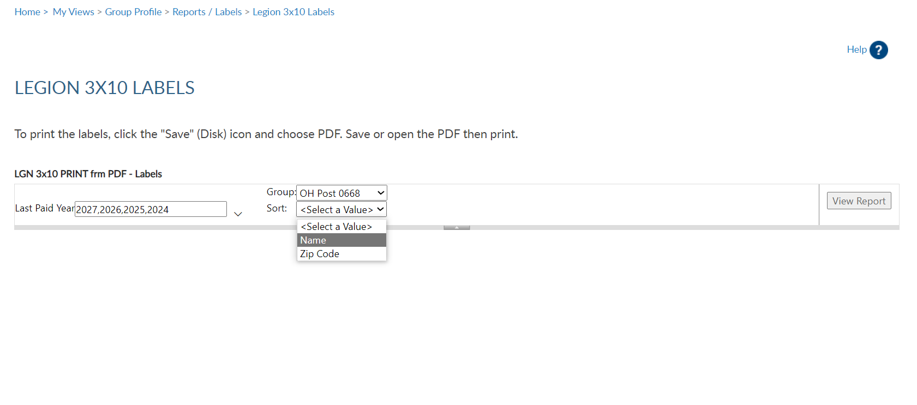
LABELS
30 per sheet mailing labels for LGN and SAL members.
Notes:
Filtering options allows you to define the members included in labels. Deceased and members flagged as undeliverable will be suppressed from mailing labels.
The first step is to select the group. Next, select the last paid year or multiple years. <3> Designate if you want your labels sorted by last name or zip code.
After parameters are set, View Report to continue. <1>

Slide 38
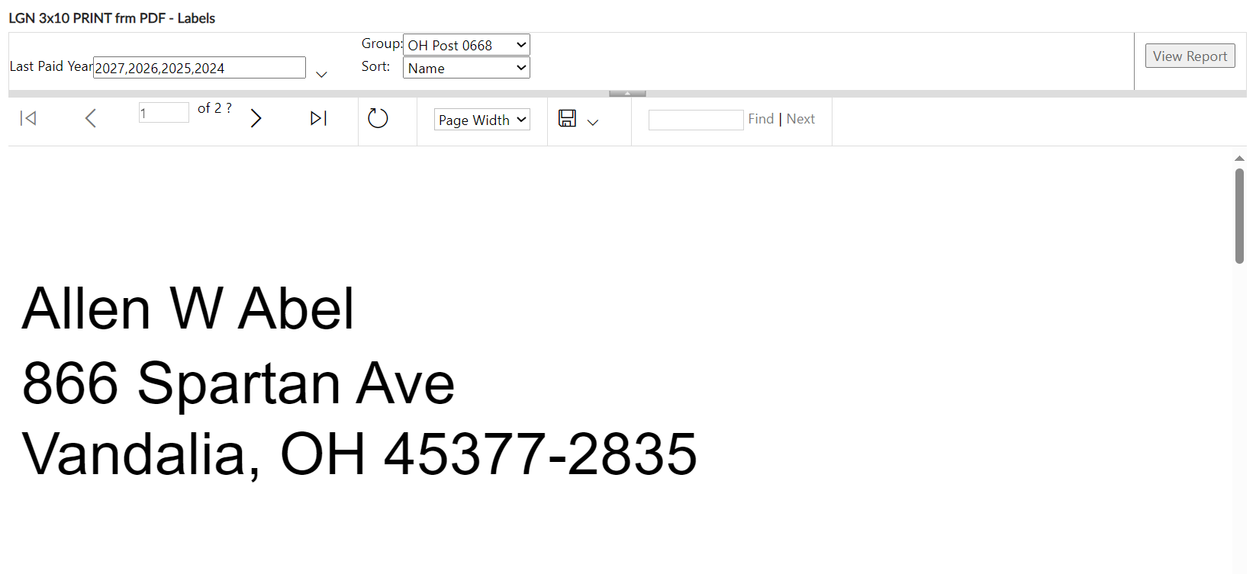
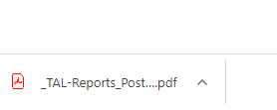
LABELS
30 per sheet mailing labels for LGN and SAL members.
Max A Sample
PO Box 123
Somewhere, OH 45377-2835
Thomas Sample
123 Main Street
Somewhere, OH 45377-2835
Notes:
The label display is not in 30/sheet format. Send the data to a PDF document selecting the export icon. <1> The export icon is used print and save all reports using the file types in the menu. PDF is the only selection that applies for labels. After you select PDF look for a tab to open the PDF generally located at the lower left of your window.

Slide 39
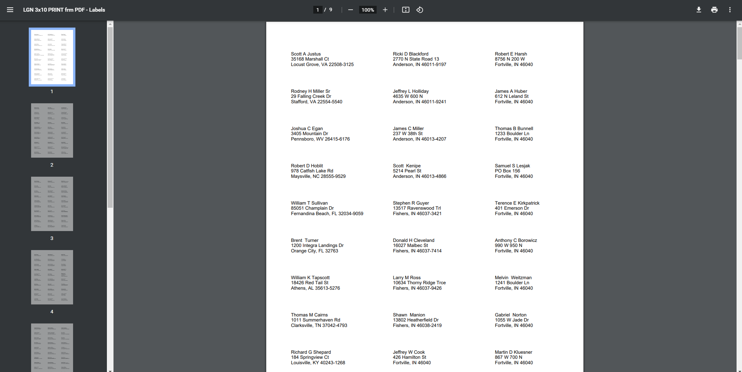
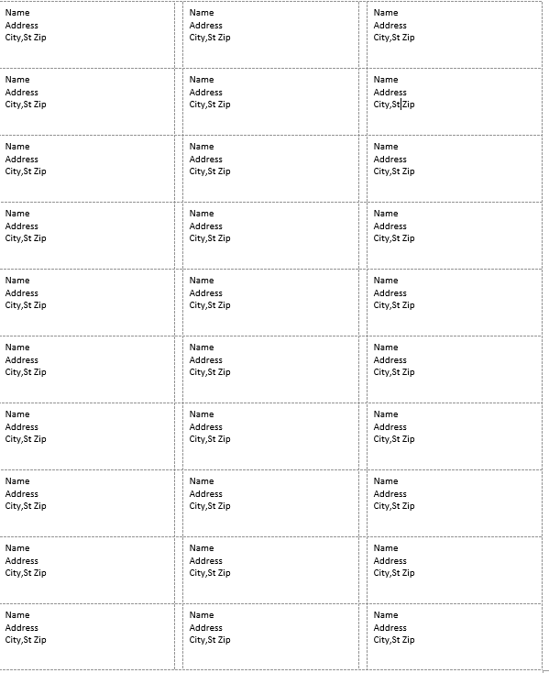
Notes:
The PDF opens to print labels. <1> Use the print icon to send to your printer.

Slide 40
Notes:
A renewal letter and labels are available to reach out to expired members.
You can create labels for renewal letters. Go to Renewal labels and use the same criteria used for letters.
<1> To create a listing of HQs post members, begin in Reports and Labels – Find Members in My Area.
This report is only available to adjutants and commanders. Access to this report is not included with group administrator’s permission.
Find Members in my Area provides contact information for Legion members in your state headquarters post within a designated area defined by zip code. Click the Find Members in my Area blue hyperlink to set parameters and create report. <1>

Slide 41
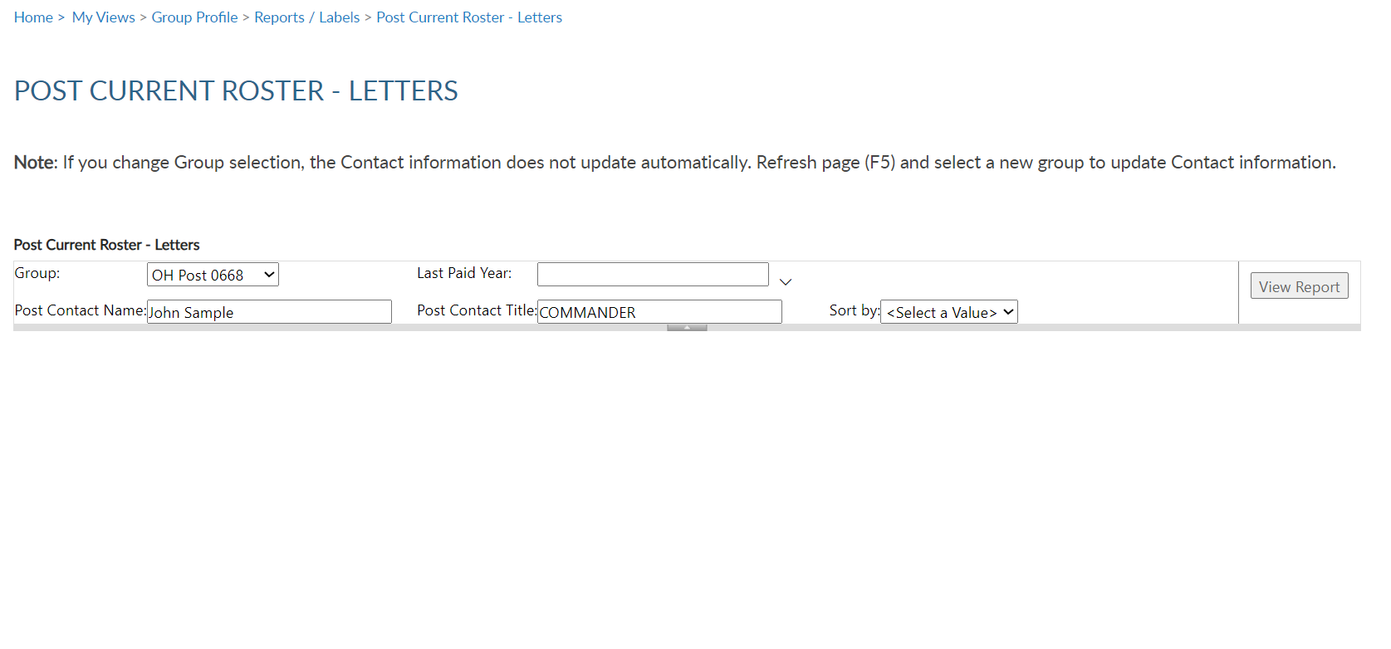
RENEWAL LETTERS
Pre-written custom letter inviting expired members to renew. Create labels for your letter using the same filter criteria.
Notes:
Creating the letter begins with filters. Select the group first. This populates the contact name and title with commander information. <1> These fields can be modified by typing new text in the fields.
<2> Enter last paid year or multiple years, and <3> sort option. Only expired years will be available. Click <4> View Report to generate.

Slide 42
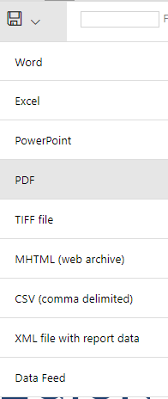
Notes:
The personalized letter generates. Letters need to be exported to print. Using the export icon, export to a PDF <1>.

Slide 43
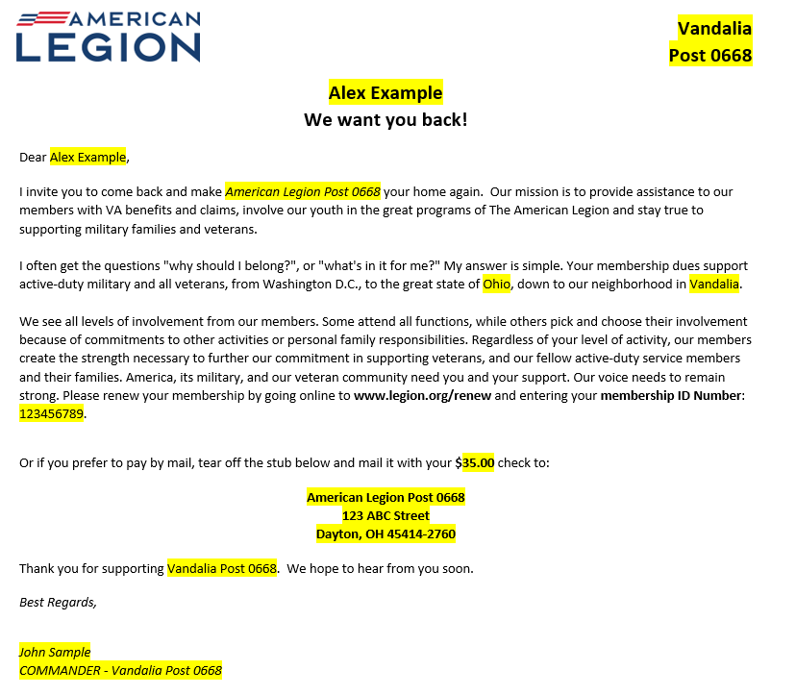
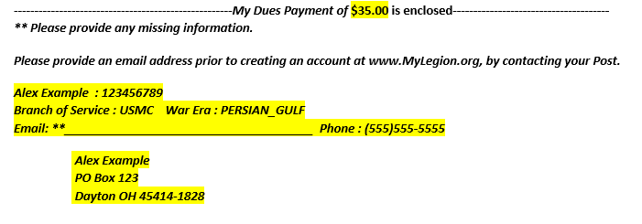
Notes:
The letter is personalized using member and post or squadron information including dues and dues remittance address. <1> The bottom of the letter includes a remittance slip with dues amount and member information. If there is missing contact information, a line is provided for the member to complete and return with dues.

Slide 44
Notes:
Create an invitation to HQ members to transfer into your post using a pre-written letter.

Slide 45
TRANSFER INVITATION LETTER
Create a letter to DMS HQ members to invite them to your post.
Notes:
Begin by selecting the group. <1> This will auto populate the post commander, email, phone number and email address that will be in the letter. This can be updated by clicking in the text boxes to update.

Slide 46
TRANSFER INVITATION LETTER
Create a letter to DMS HQ members to invite them to your post.
Notes:
Enter the zip code. Only zip codes in your state are available.

Slide 47
TRANSFER INVITATION LETTER
Create a letter to DMS HQ members to invite them to your post.
Notes:
Last paid year includes current and past membership years. Members that respond to the invitation that are paid for the current membership year, will have to be submitted using a Member Data Form to your department.

Slide 48
TRANSFER INVITATION LETTER
Create a letter to DMS HQ members to invite them to your post.
Notes:
Generate the letters by clicking “View Report”.

Slide 49
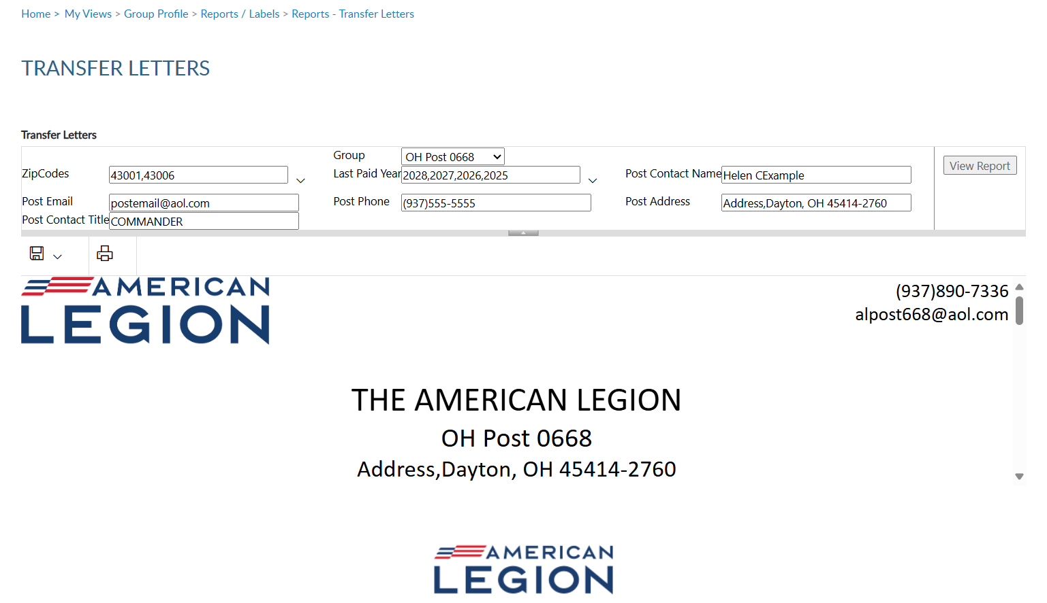
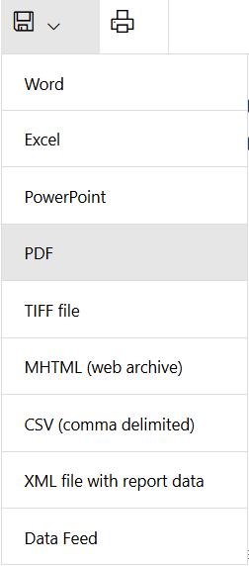
TRANSFER INVITATION LETTER
(937)555-5555
postemail@aol.com
Notes:
Use the export icon to send the letters to a PDF printable document.

Slide 50
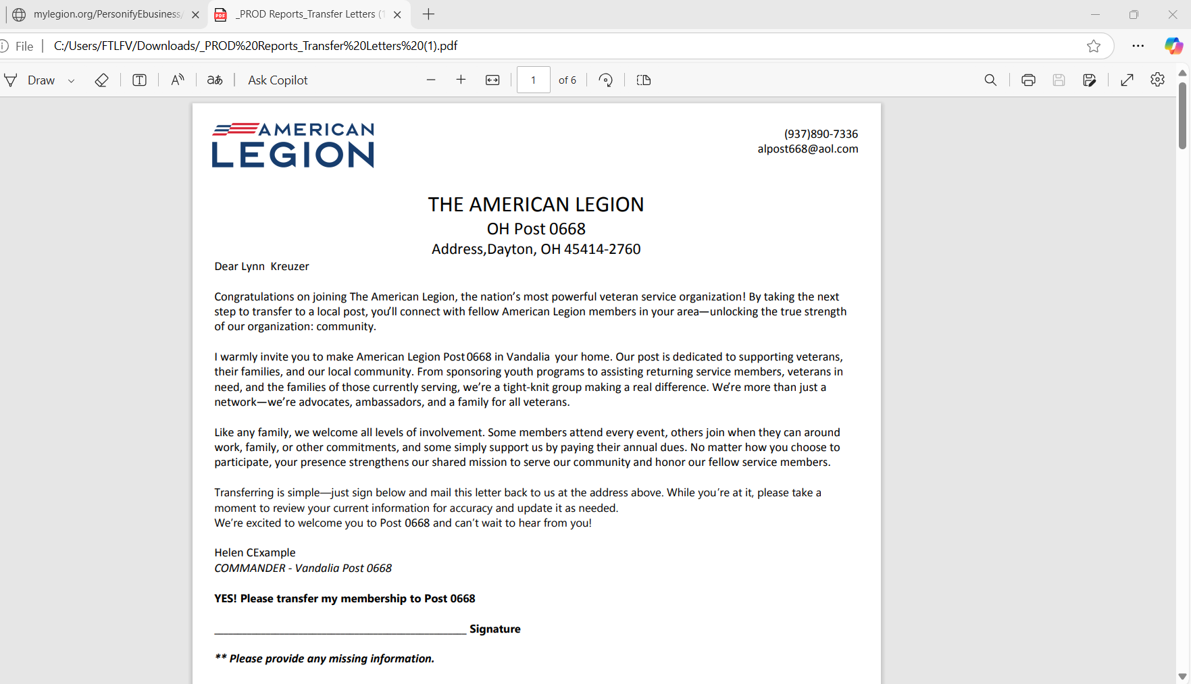
TRANSFER INVITATION LETTER
(937)555-5555
postemail@aol.com
Dear Jane Example
Notes:
The letter is personalized with the member’s name and post information.

Slide 51
TRANSFER INVITATION LETTER
(937)555-5555
postemail@aol.com
Dear Jane Example
Notes:
It includes a signature line authorizing the transfer.

Slide 52
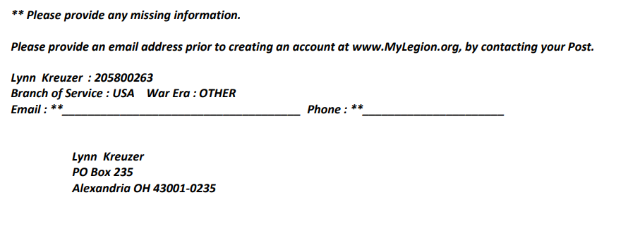
TRANSFER INVITATION LETTER
(937)555-5555
postemail@aol.com
Dear Jane Example
Jane Example : 111222333
Jane Example
PO Box ABC
Alexandria OH 43016
Notes:
The bottom of the letter provides the member opportunity to complete any missing information. In addition, the member’s name and address is located where you can use a window envelope.

Slide 53
Notes:
HQ members are located using Find Members in My Area. This listing can be generated 2 ways.

Slide 54
FIND MEMBERS IN MY AREA
Distance From Zip: Locate headquarters post members using distance, 1 zip code and last paid year search.
Notes:
Distance From Zip Code lets you select distance, zip code, and last paid year. Only one zip code can be selected when using find members in my area by distance. All zips are within your state. This report is not to be used to locate members in other departments. <1> Click ”View Report” to generate.

Slide 55
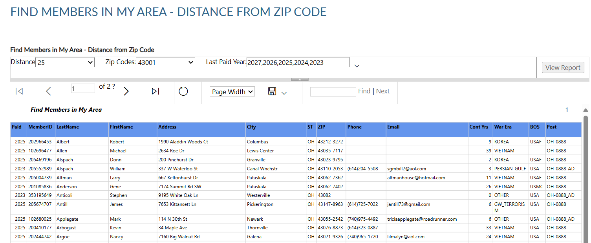
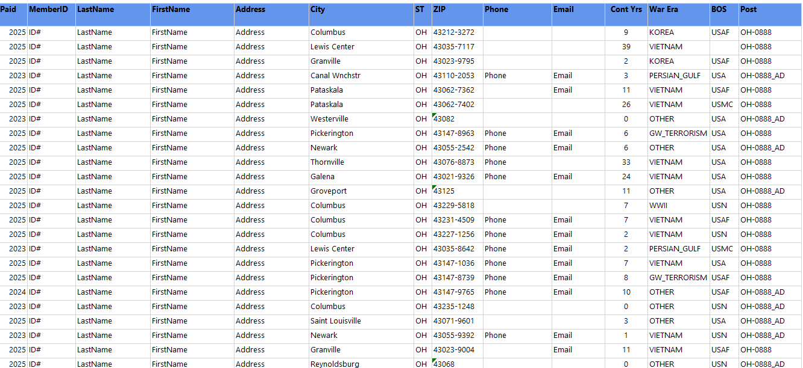
Notes:
This listing can be exported to save or print using the export icon. <1>

Slide 56
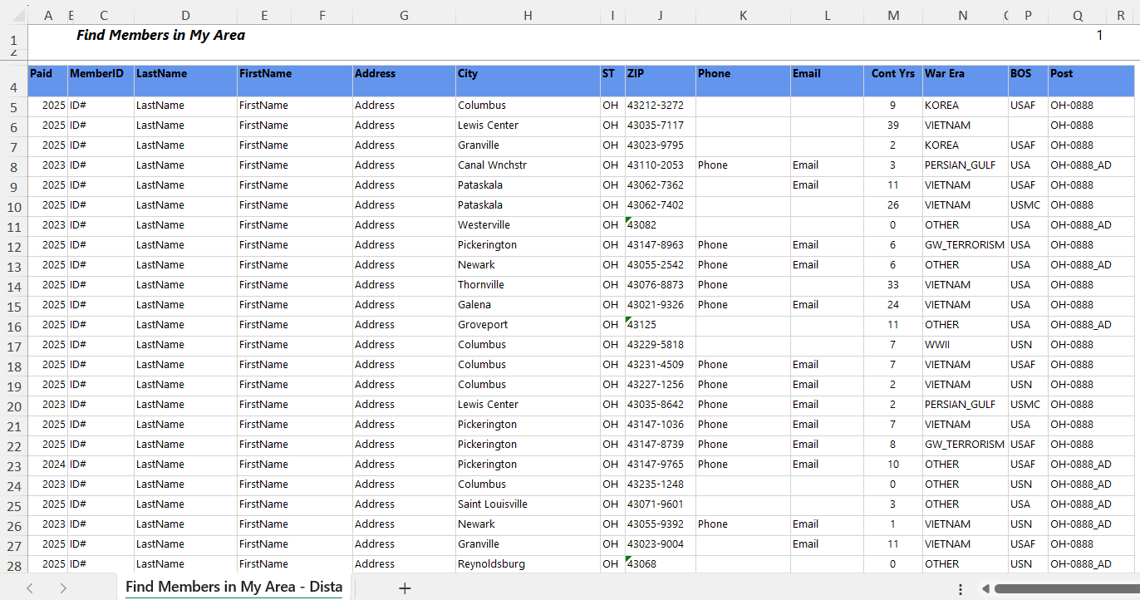
Encumbered only relates to HQ Post members.
A member that joins through the national DMS program is placed into a HQs post and dues are encumbered (AD) to national HQ until the member renews twice or is transferred to a a local post.
Notes:
The report includes contact information to reach out and invite them to transfer to your local post. Post numbers that include AD <1> are encumbered members. Encumbered only relates to HQ Post members. HQ post member’s join through the national DMS program and are placed into a HQs post. Dues are encumbered to national HQ until the member renews twice or is transferred to a local post.

Slide 57
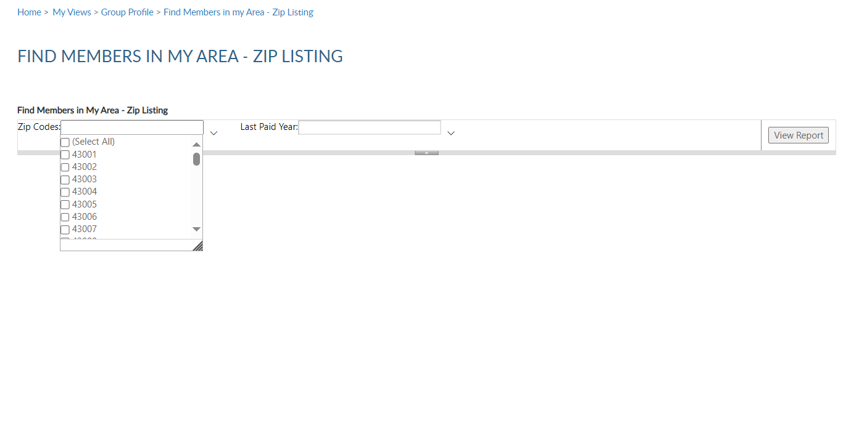
FIND MEMBERS IN MY AREA
By Zip Listing: Locate headquarters post members using multiple zip codes and last paid year search.
Notes:
The other Find Members in my Area Report by Zip listing allows entry of multiple zip codes within your state and last paid years. <1>

Slide 58
Notes:
The report is the same but with different data based off filter selections.

Slide 59
Notes:
Locate members who have moved into your area within the last 45 days using the Project Stay Active listing.

Slide 60
Locate members who have moved into your area within the last 45 days.
PROJECT STAY ACTIVE
Notes:
Choose zip code and distance and View Report.

Slide 61
Notes:
The listing provides contact information to welcome the member to the community, introduce them to your post or squadron and invite them to transfer. As with all other report, export to save or print. <1>

Slide 62
Notes:
Monitor who has access to your group in MyLegion using the MyLegion Access report.

Slide 63
MYLEGION ACCESS
Monitor who has access to your group in MyLegion. Adjutants and Commanders have access by default.
Notes:
The group menu displays who you have access to maintain. District and county administrators will have a listing of all posts or squadrons in your group. Click View Report. <1>

Slide 64
Notes:
Adjutants and Commanders will have access by default and have access to manage permissions. To update permissions, search the member record and go to Assign Group Permissions.

Slide 65
Notes:
Post/Squadron Health Status report is for district and county officers.

Slide 66
POST HEALTH STATUS
Monitor post and squadron membership processing and consolidated reporting.
Notes:
Monitor membership processing and consolidated reporting for posts and squadrons in your group. Group selection will include district and county groups. Enter your group, last paid year and <1> View Report.

Slide 67
Notes:
The list provides post or squadrons with their last transmittal date, number of unpaid members, consolidated report status, and address information.
To return to MyLegion home or group profile window, use the breadcrumb links at the top of the page. <1>

Slide 68
Online Help
emailaddress@yahoo.com
000123456789
Expired
000123456789
Notes:
Online help is available from the top Menu “Find Help”.
Step by step instructions, videos and training presentations will assist with how to manage groups in MyLegion.

Slide 69
Online Help
Notes:
Step by step instructions, videos and training presentations will assist with how to manage groups in MyLegion. My Groups instructions include managing membership, online, membership processing, reports and all other administrative tasks.

Slide 70
MYLEGION SUPPORT
MyLegion@legion.org
833.253.9995
Monday – Friday
8:00am – 4:30pm
(Eastern)
The American Legion National HQs
5745 Lee Road
Indianapolis, IN 46216
Contact your MyLegion support team to assist with any questions or tools on your MyLegion account.
Notes:
Contact your myLegion support team to assist with questions and tools for MyLegion. Email mylegion@legion.org or call 833-253-9995 Monday through Friday.

